Slide 1
Datums
A datum defines the starting point from which coordinates are measured.
To map locations on earth, an approximation of the earth’s surface must be calculated to provide a reference surface.
The datum defines the size and shape of the ellipsoid used to approximate the shape of the earth.
A datum is a formal description of the shape of the Earth along with an "anchor" point for the coordinate system.

Slide 2
A horizontal, local datum serves as a basis for measurements over a limited area of the earth & has its origin at a location on the earth's surface.
NAD27 is a horizontal datum used to define the geodetic network in North America.
It was based on surveys of the entire continent from a common reference point that was chosen in 1901, because it was as near the center of the contiguous United States as could be calculated.

Slide 3
The North American Datum of 1927 (NAD27) uses a starting point at a base station in Meades Ranch, Kansas and the Clarke Ellipsoid to calculate the shape of the earth.

Slide 4
Satellites are a better model and resulted in the development of the North American Datum of 1983 (NAD83). Depending on one's location, coordinates obtained using NAD83 could be hundreds of meters away from coordinates using NAD27. A third datum, WGS84 is identical to NAD83 for most practical purposes within the United States. The differences are only important when an extremely high degree of precision is needed.
WGS84 is the default datum setting for almost all GPS devices. But most USGS topographic maps published up to 2009 use NAD27.

Slide 5
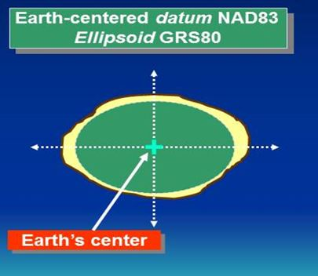
For datums NAD83 and WGS84, the shape of the earth (the ellipsoid) is measured from the center of the earth’s mass.

Slide 6
?
A
B

Slide 7
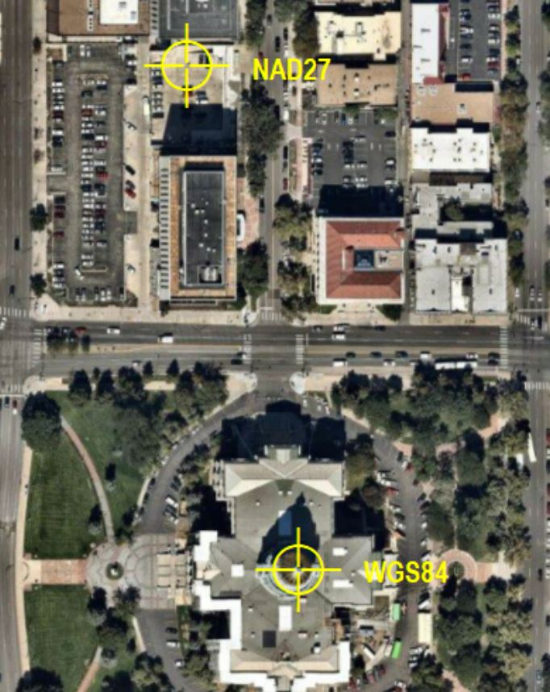
A marker was placed on the Colorado Capitol using WGS84 datum
Then the datum was changed to NAD27, and a marker was placed using the WGS84 coordinates.
The NAD27 coordinates were 46 meters too far west, and 208 meters too far north.

Slide 8
Good 7-minute training video about datums
https://www.coursera.org/lecture/spatial-analysis/datums-6q7Wb

Slide 9
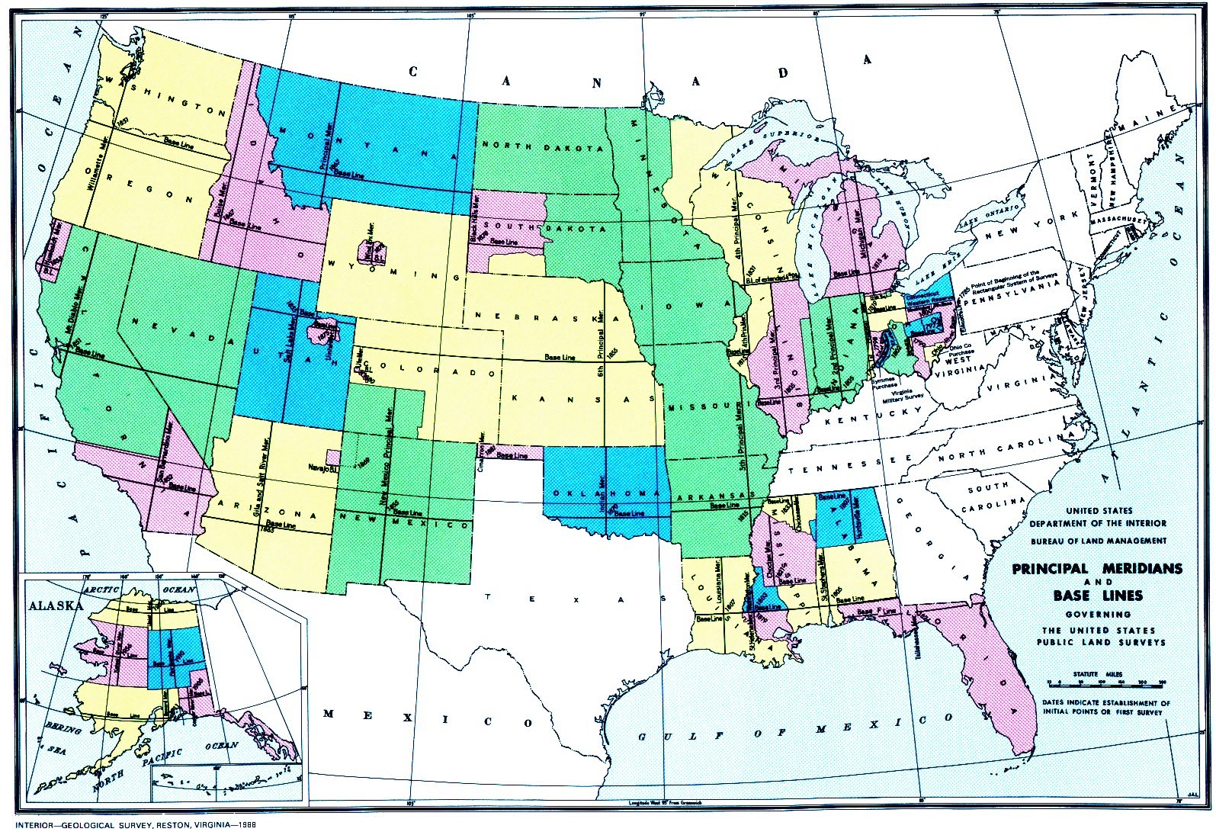
Public Land Survey System

Slide 10
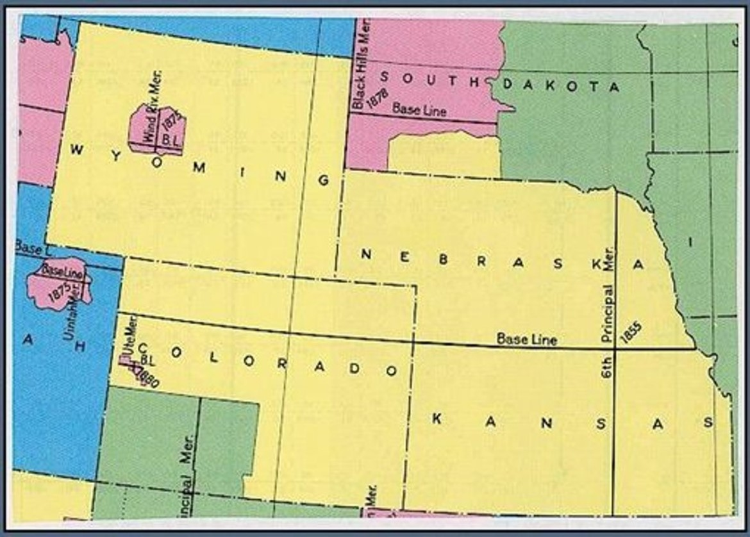
Initial Point
Notes:
Original survey data is instrumental in determining the trail’s location.
Colorado is surveyed by the 6th Principal Meridian of the Public Land Survey System. 36 square mile townships are numbered north, south, east and west of the intersection of the base line and the principal meridian, known as the initial point.

Slide 11
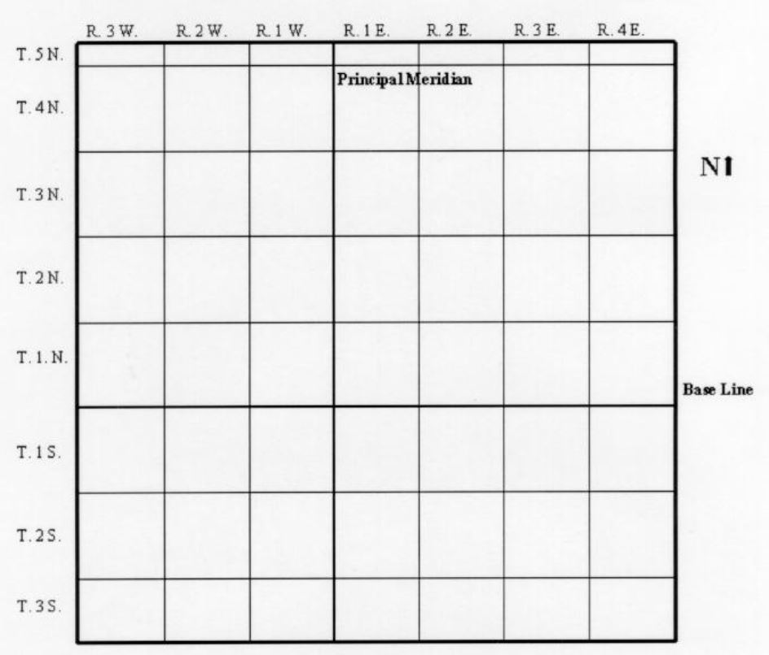
Townships are numbered north and south of the baseline, shown in red.
Ranges are numbered east & west of the meridian line shown in blue
Notes:
Townships are numbered north and south of the red baseline.
Ranges are numbered east and west of the blue meridian line
For example, Township 2 North, Range 3 West, would be the second township north of the baseline, and the 3rd range west of the meridian line.

Slide 12
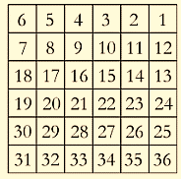
Here is the layout of a township, showing the 36 sections, each one mile square.
with adjoining township sections
6 Miles by 6 miles
36 Sections
1 mile = 5280 feet
1 chain = 66 feet
1 mile = 80 chains
80 x 66 = 5280 feet

Slide 13
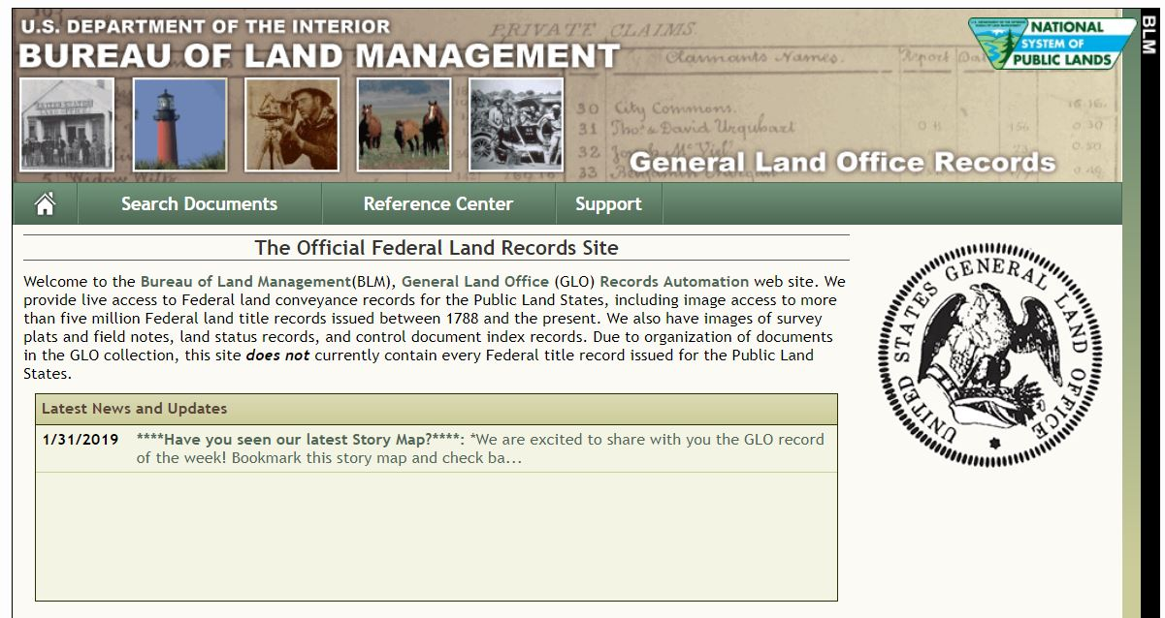
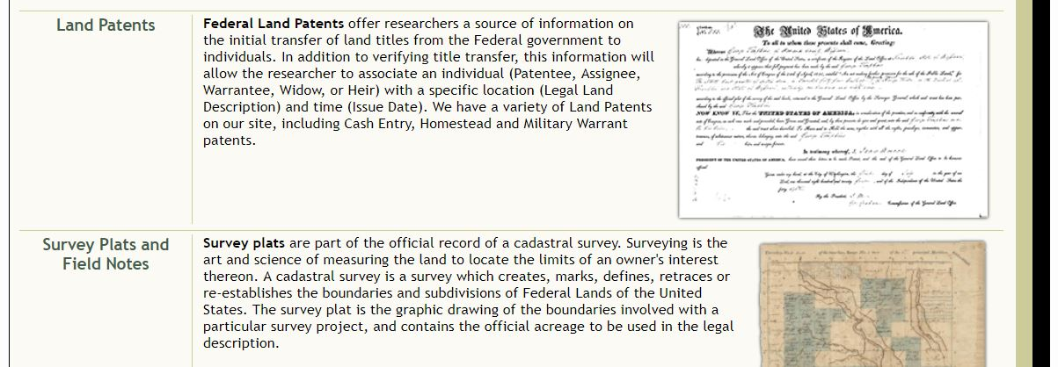
Many states’ original survey plat maps and notes are available on the national BLM website
METHODS TO OBTAIN THE SURVEYORS’ NOTES AND MAPS
https://glorecords.blm.gov/default.aspx
click the “Survey Plats and Field Notes”

Slide 14
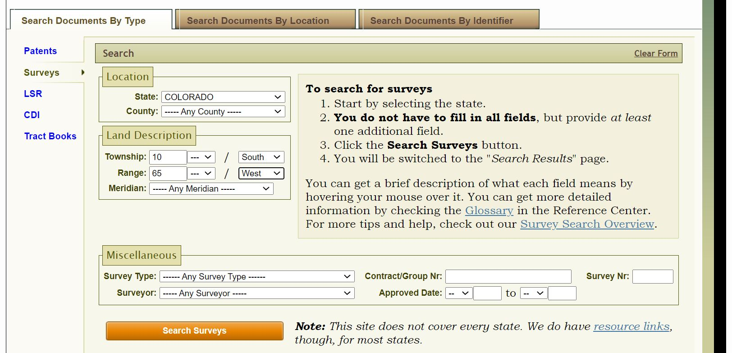

Slide 15
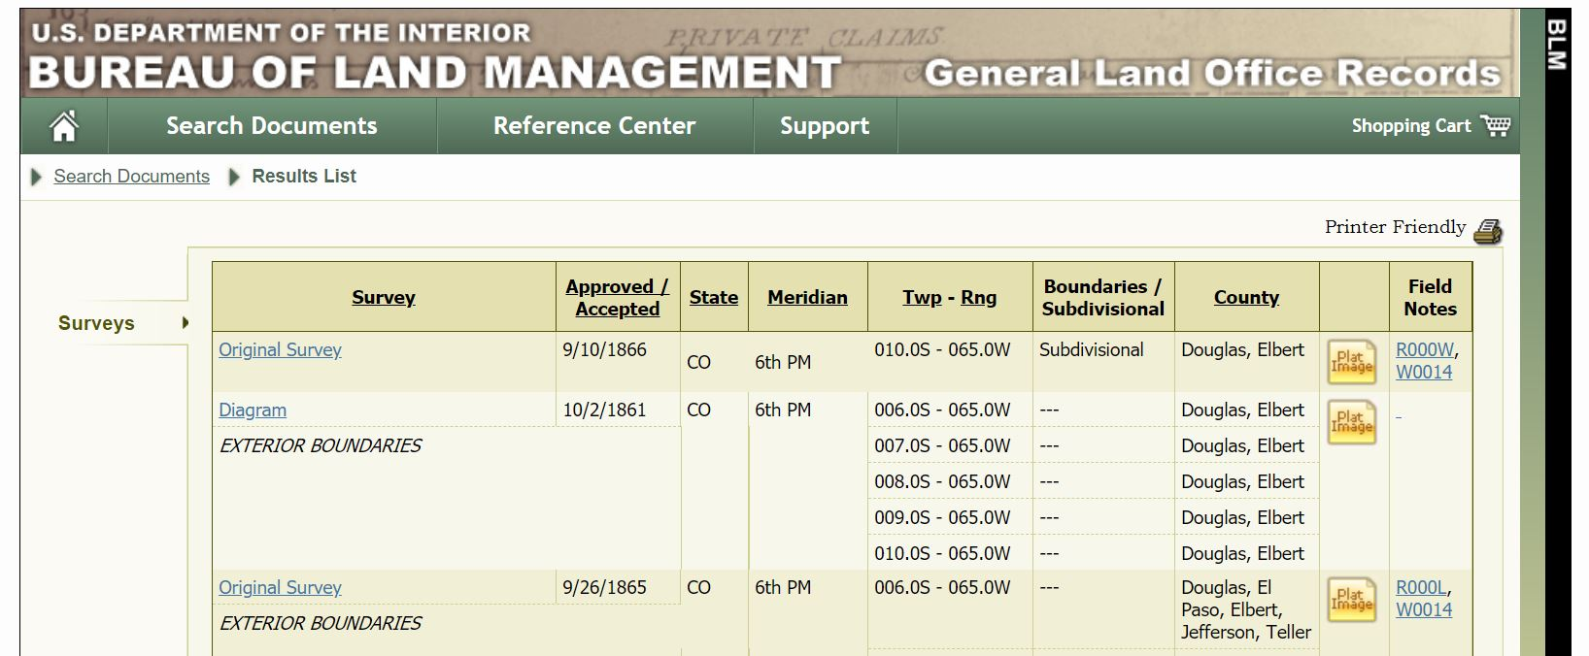
Original Survey
Subdivisional
GLO Plat Map

Slide 16
To download click on PDF icon

Slide 17
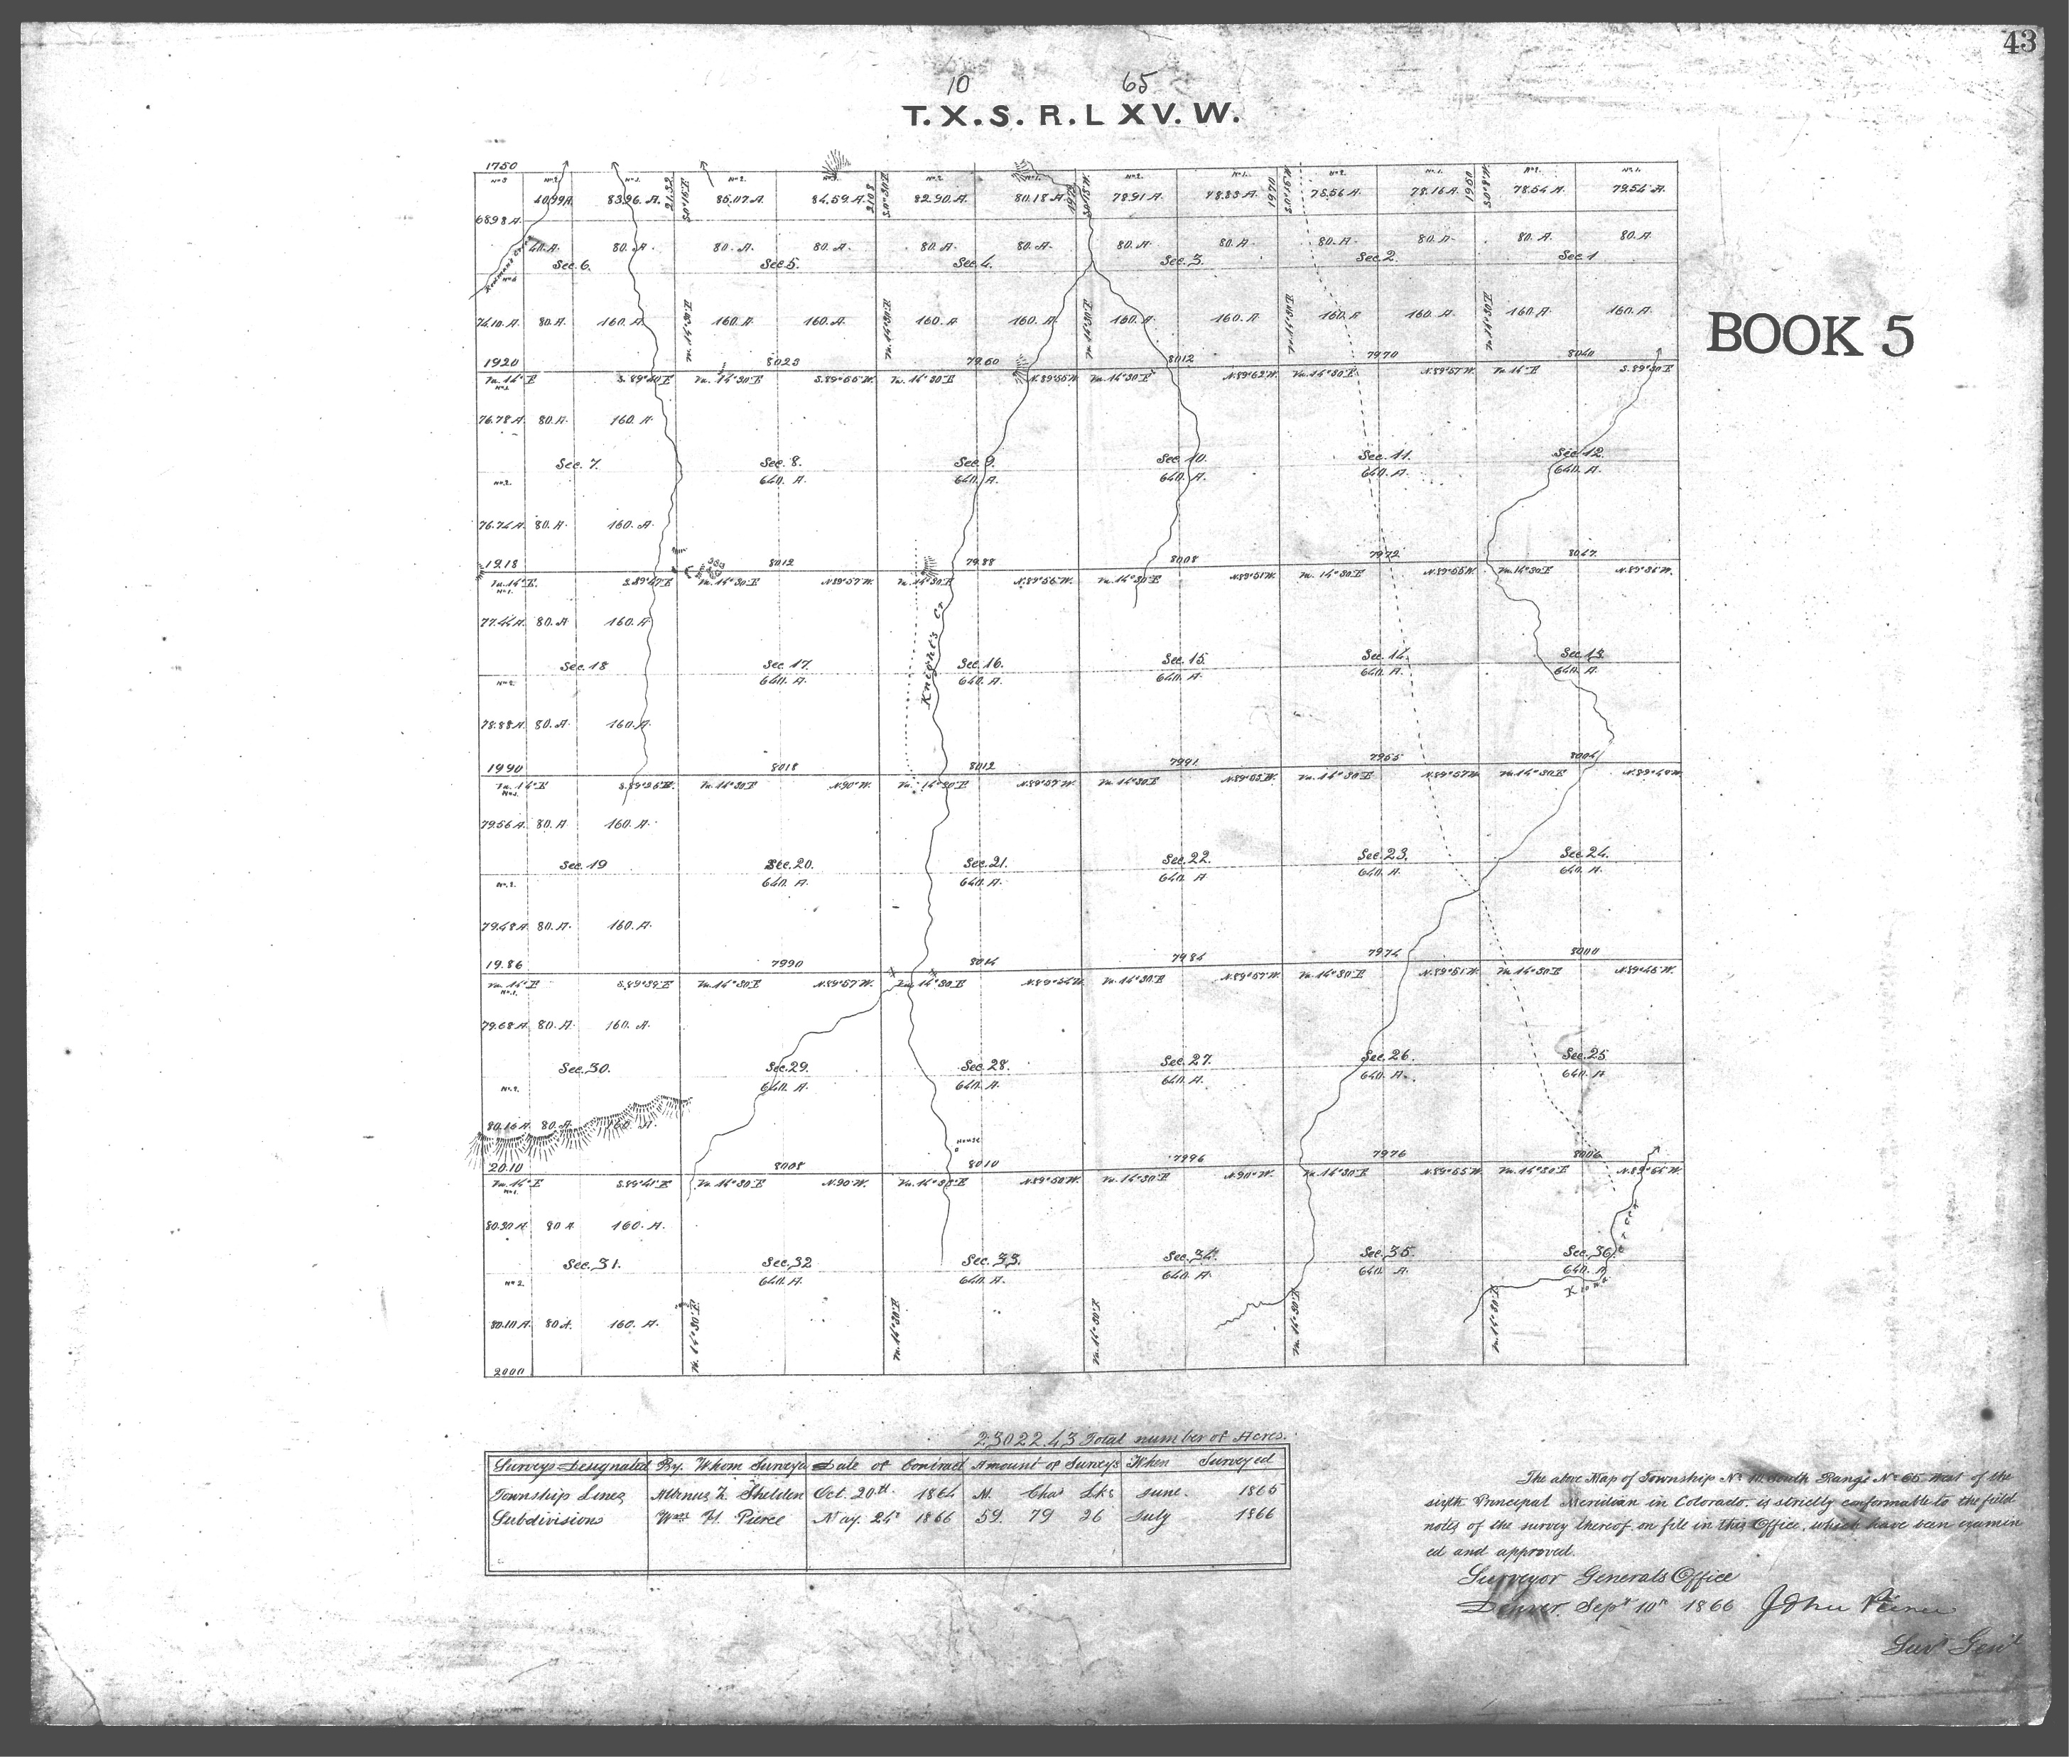

Slide 18
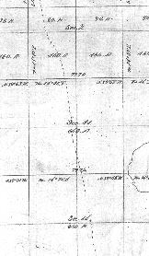
Need surveyor’s chain measurement between sections 2 & 11
Sec 11

Slide 19
https://glorecords.blm.gov/default.aspx
Surveyor’s field notes

Slide 20
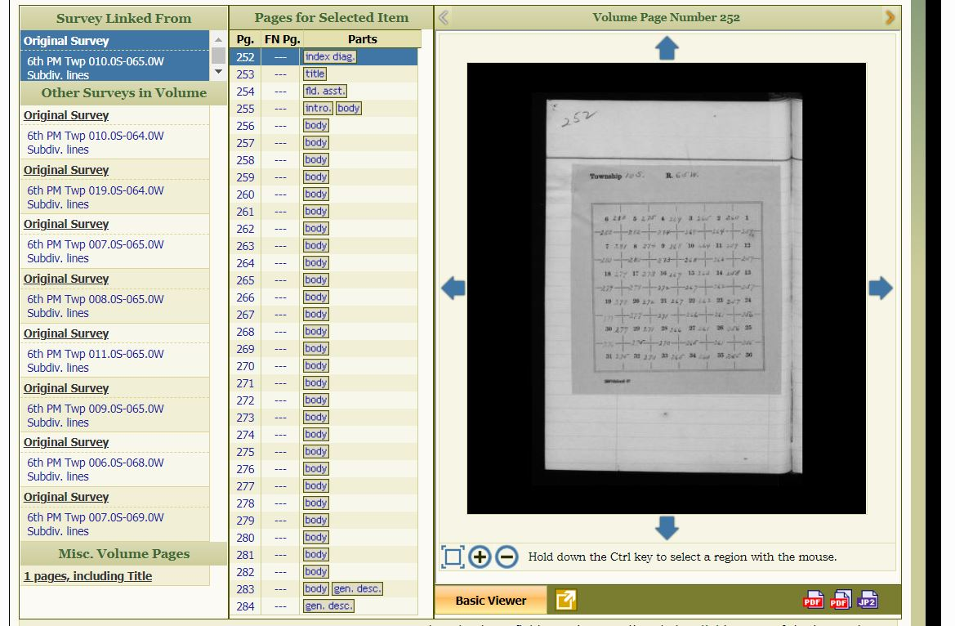
Click on index diag
Displays this page

Slide 21
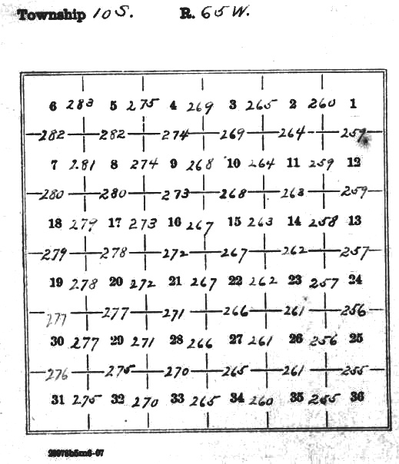
Notes for section line between sections 2 & 11 on page 264

Slide 22
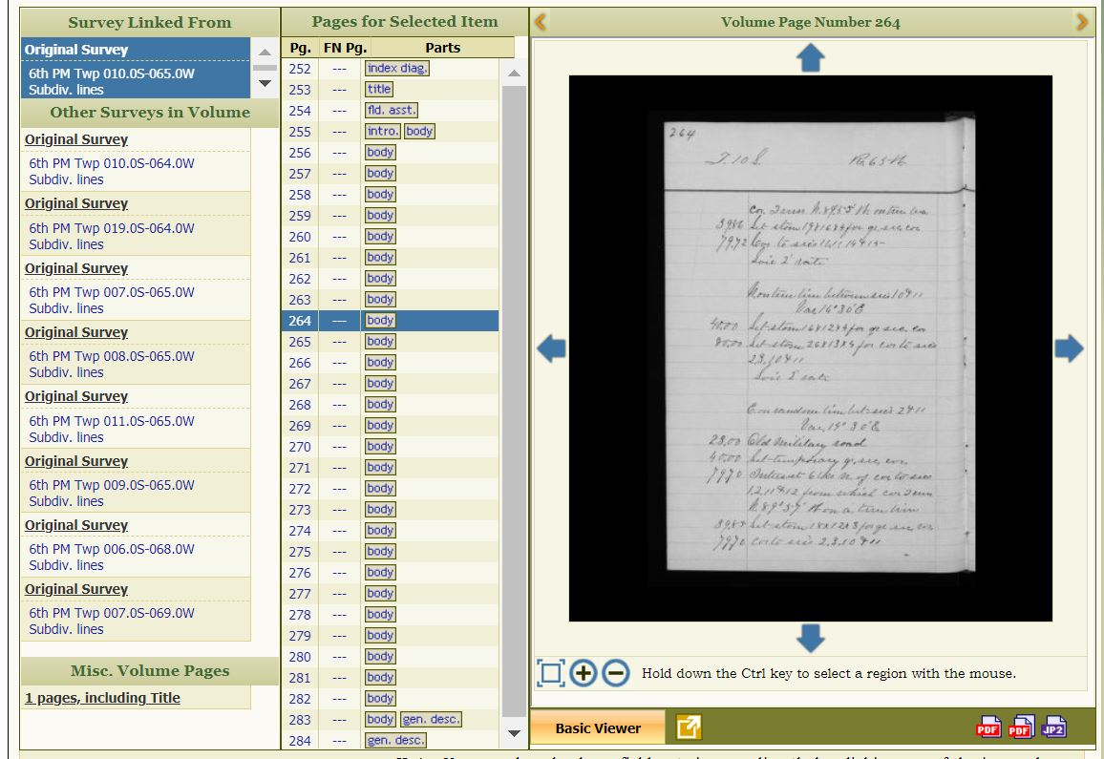
Page 264

Slide 23
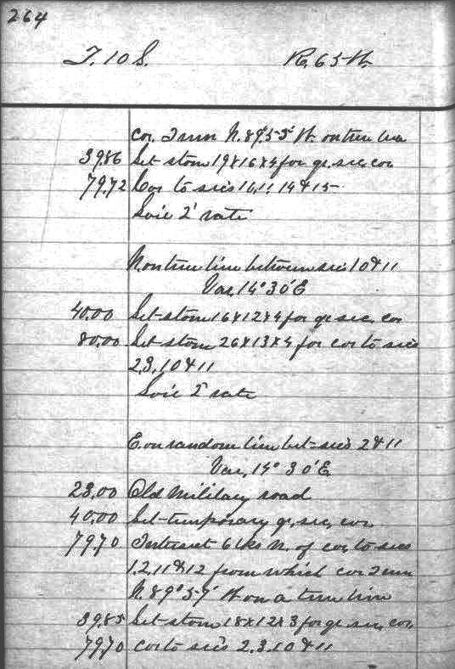
East between secs 2 & 11
23 chains Old military road

Slide 24
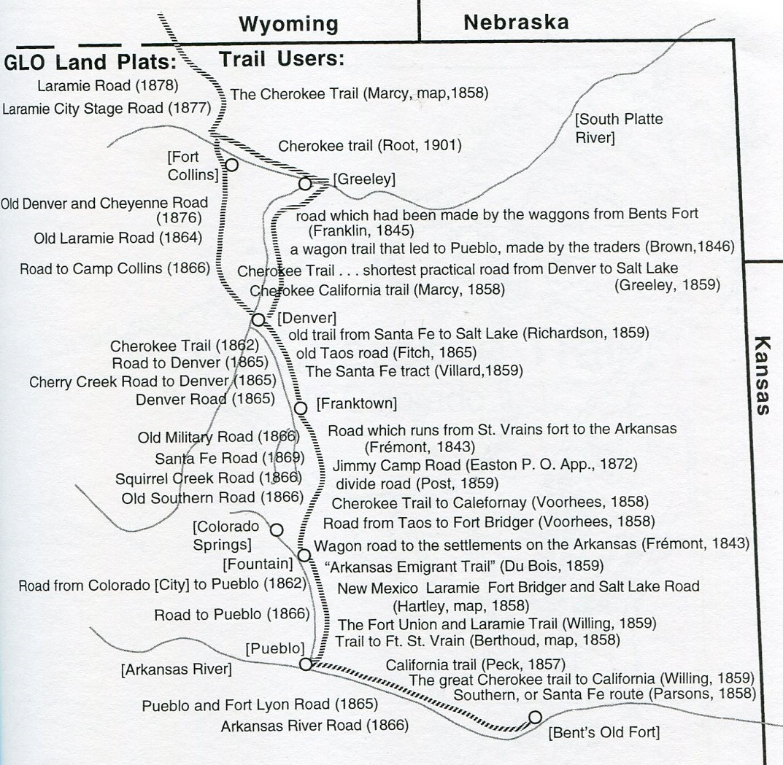
Lee Whiteley
Notes:
As this slide demonstrates, the trail had many names. One was the Trappers or Taos Trail, which connected Taos to Ft. Laramie. Another was the Overland Trail, and as shown, many more. This diversity of names complicates mapping research.
.

Slide 25
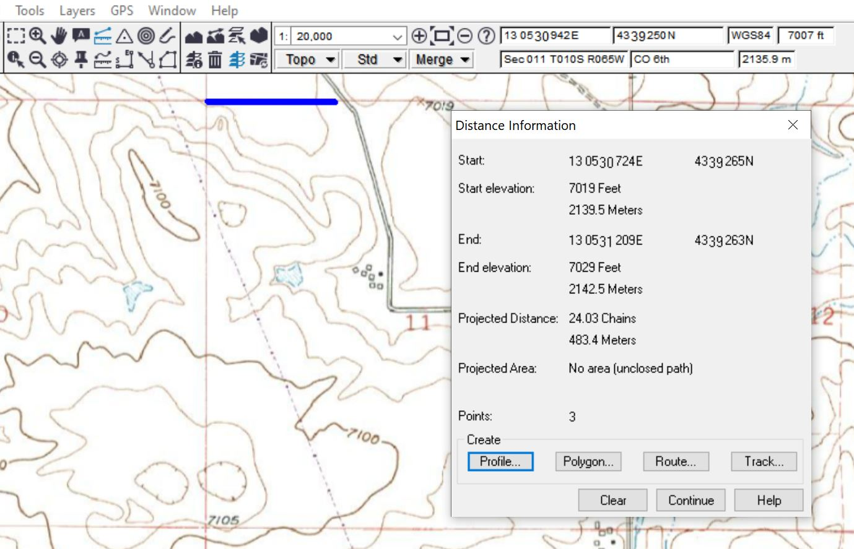
Hand-drawn Distance Tool
24.03 chains: 67.98 feet too far

Slide 26
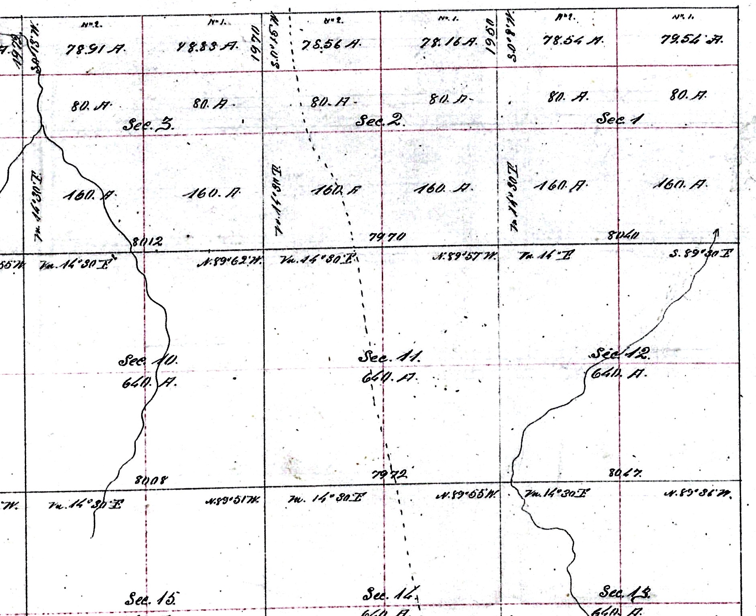
The way we used to calculate section line crossings
X

Slide 27
Need UTM coordinates for both ends of the section line
X
X

Slide 28
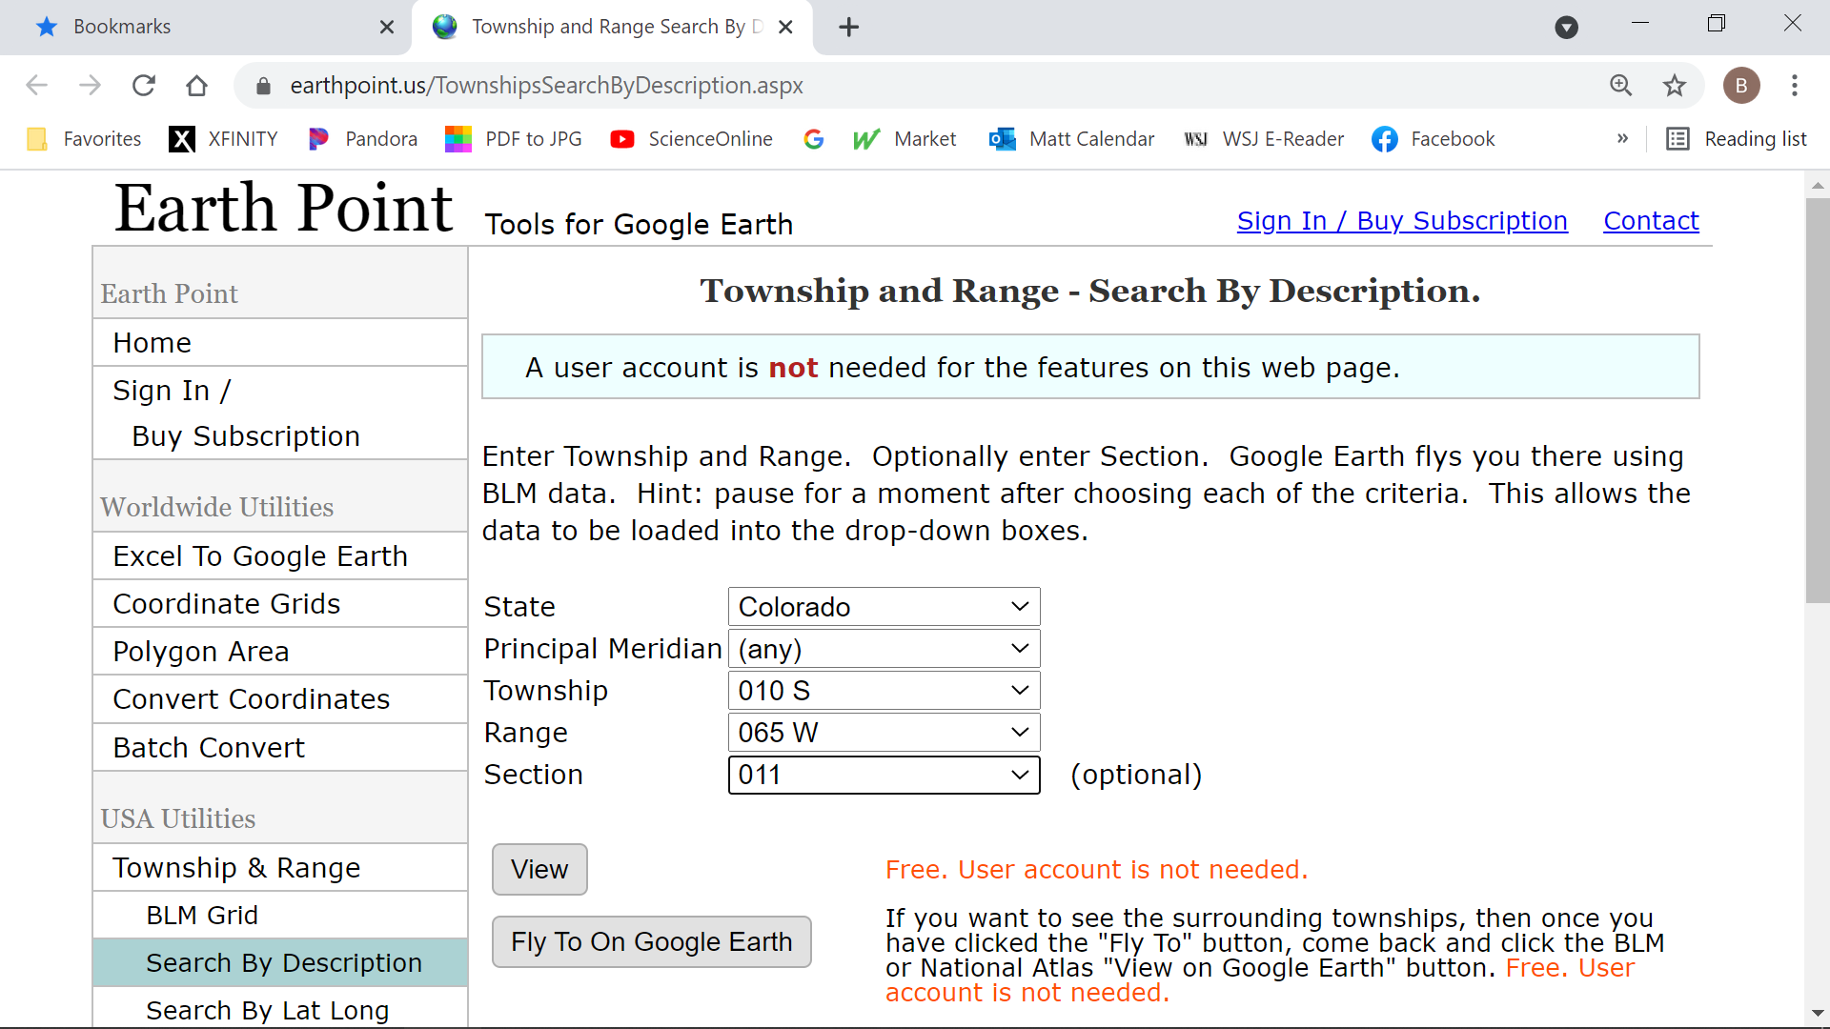
https://www.earthpoint.us/TownshipsSearchByDescription.aspx

Slide 29
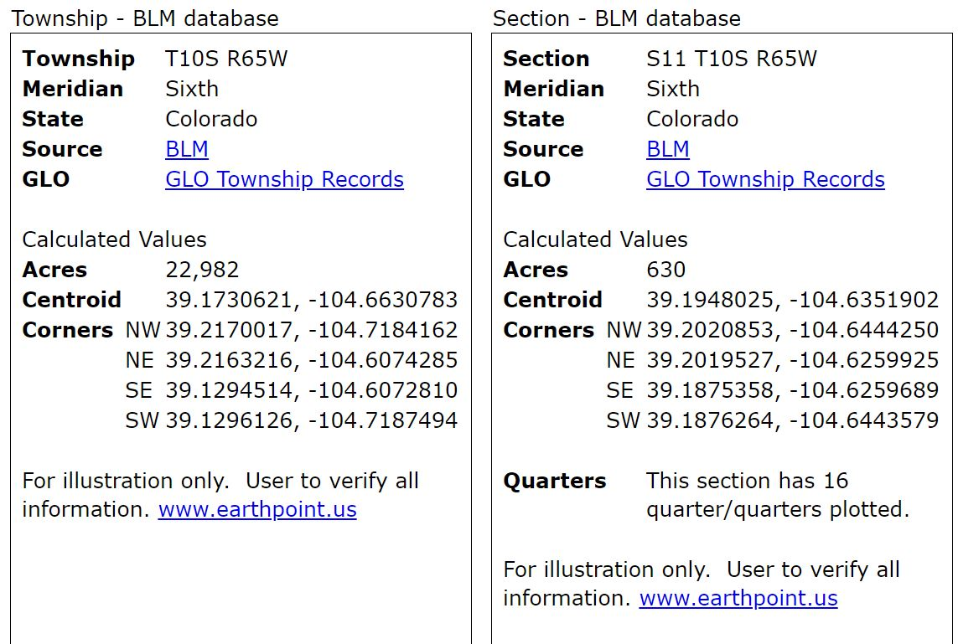

Slide 30
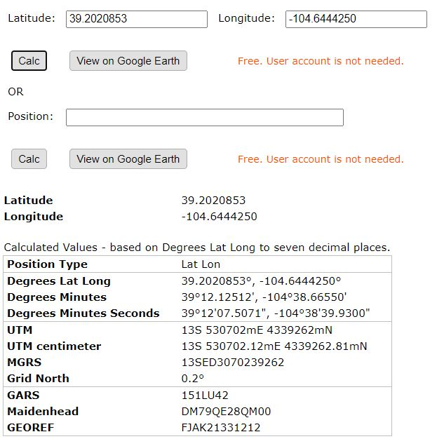
Lat/long copied and pasted
Pressing calc displays conversion
UTM coordinates for NW corner of section 11
https://www.earthpoint.us/convert.aspx

Slide 31
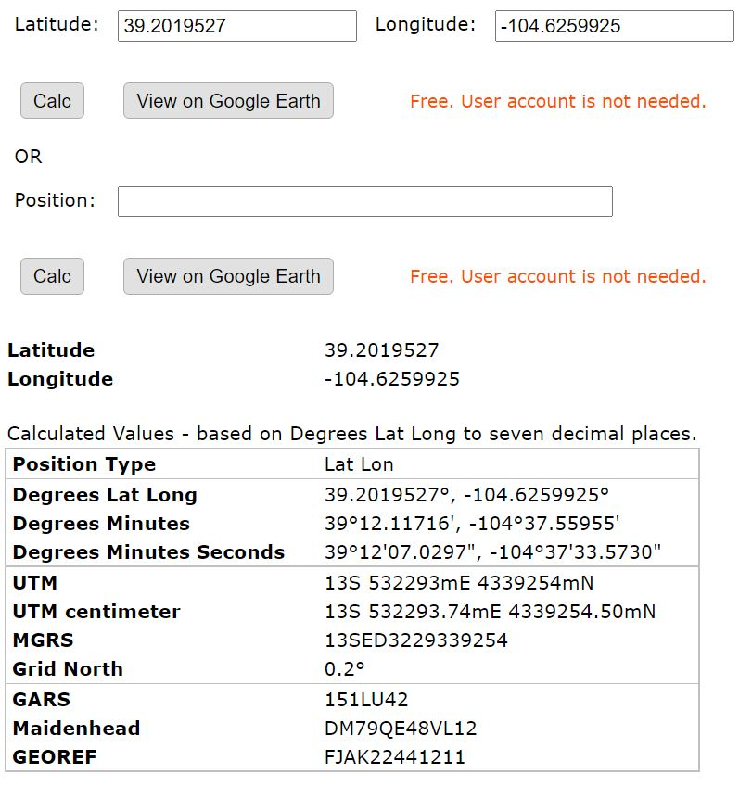
Lat/long copied and pasted
UTM coordinates for NE corner of section 11

Slide 32
The section line UTM coordinates and chain measurements pasted into the spreadsheet

Slide 33
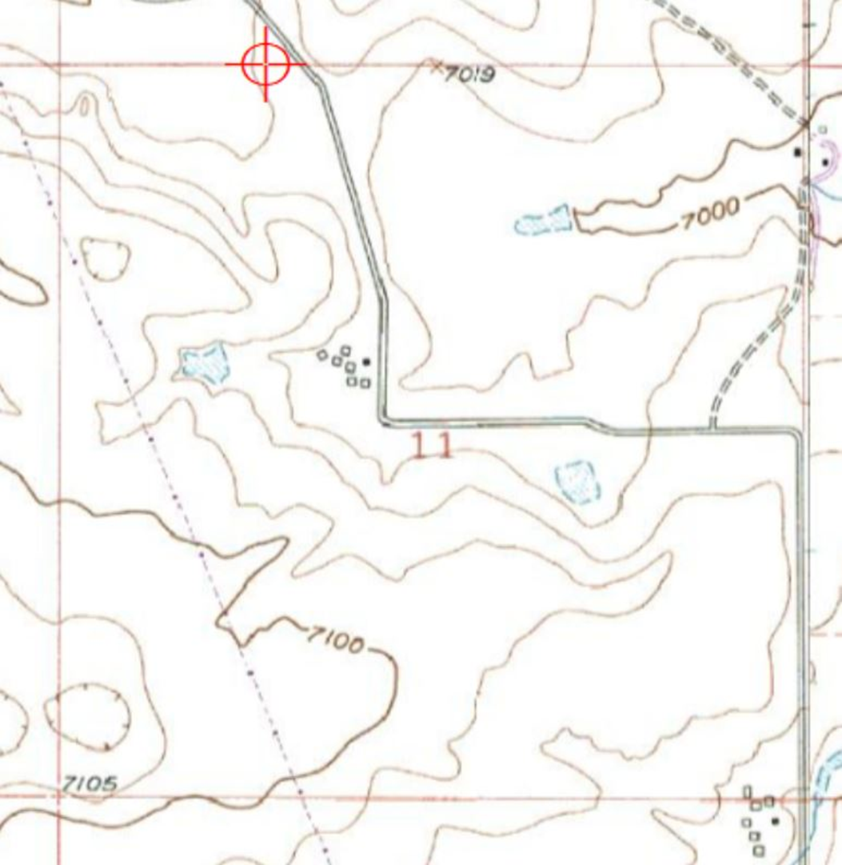
Calculated section line crossing
531159mE 4339260mN

Slide 34
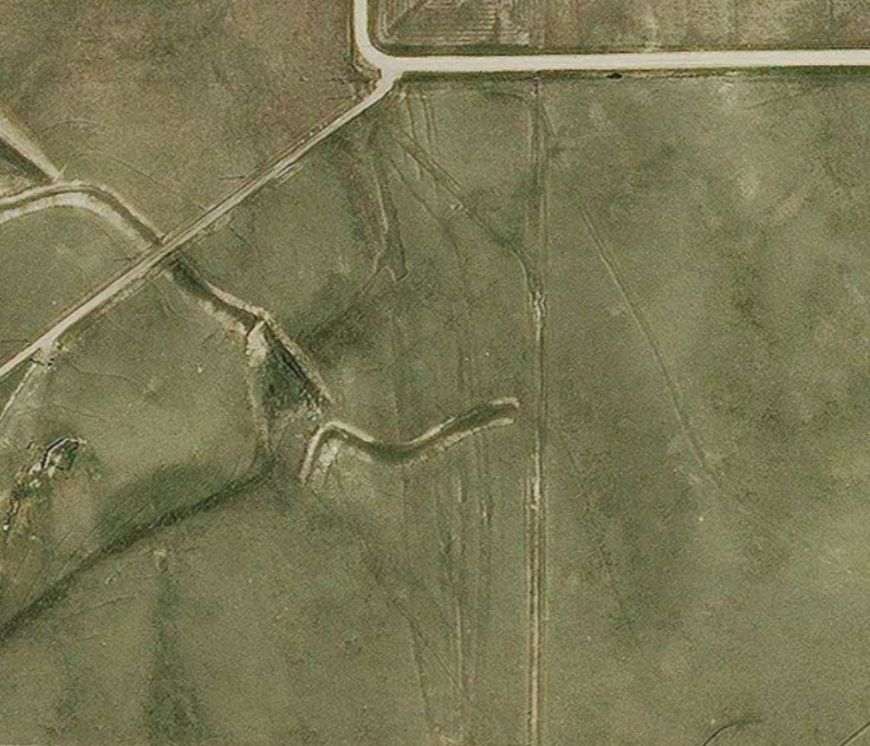
Rhudy ruts
T10S, R65W Section 11

Slide 35
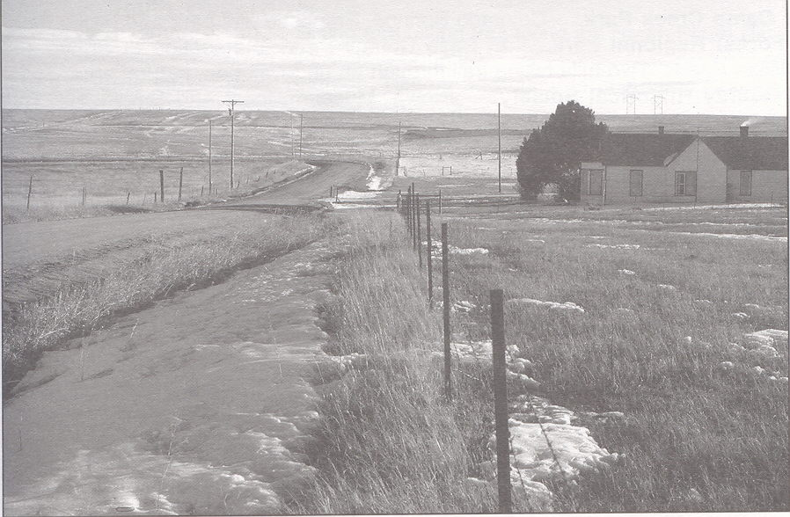
Rhudy ruts
T10S, R65W Section 11

Slide 36
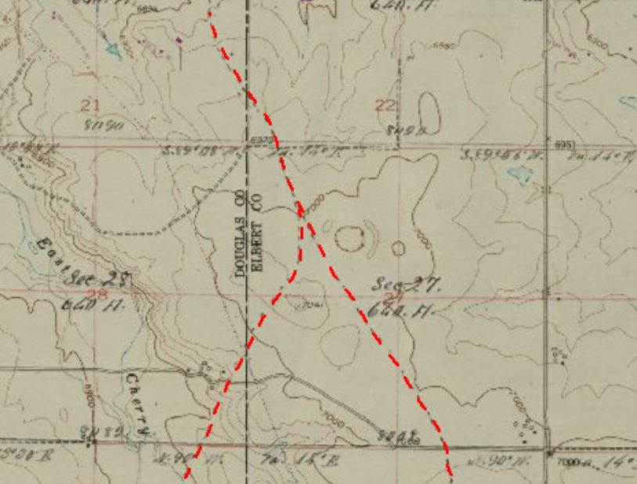
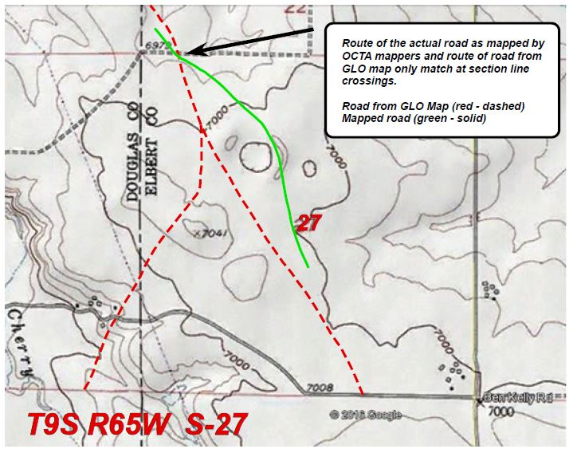

Slide 37
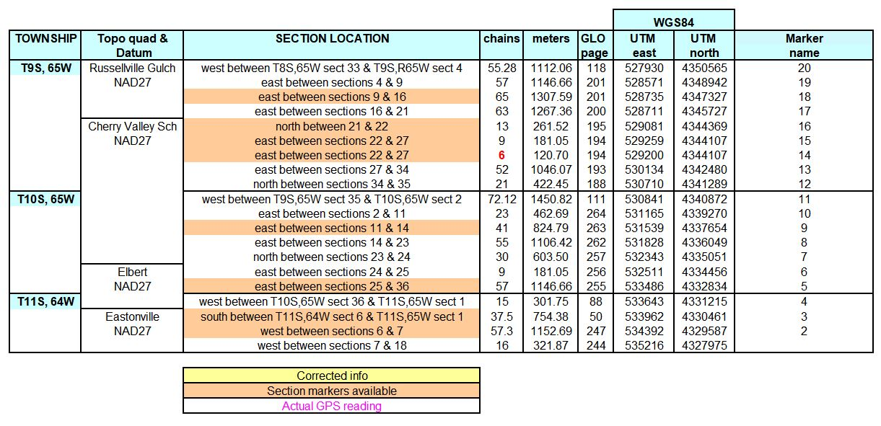

Slide 38
Self-paced PowerPoint mapping lessons
Notes:
We will provide a series of self-paced PowerPoint lessons to teach mapping technology.

